Slide 1
Electron microscope
By
Dr. Nelson Xess
Department of Microbiology
Bhanupratap Deo Govt. P.G College, Kanker, Chhattisgarh

Slide 2
Electron microscope
Because the wavelength of an electron beam is 100,000 times shorter than the wavelength of visible light photons, electron microscopes have far greater detection power than optical or light microscope . These microscopes can provide a structural image of the smallest objects with a resolution better than 50 picometers. Electron microscopes have a magnification of more than 10 million times, while optical microscopes have a resolution of 200 nanometers and a magnification of less than 2000 times due to the limitation of the diffraction phenomenon.

Slide 3
Type of electron microscopes
Transmission Electron Microscope (TEM)
Scanning Electron Microscope (SEM)

Slide 4
Transmission Electron Microscope (TEM)
A transmission electron microscope employs an electron beam produced at high voltage to brighten the specimen and produce an image to be viewed.
The working principle of this microscope is that the electrons pass through the exhibit and create a projection image of the specimen.
TEM is typically used to view thin samples such as molecules, tissue sections etc.
TEM is similar to other microscope but it used to achieve a very degree of magnification thereby allowing the observation of specimens at a nanometer level.

Slide 5
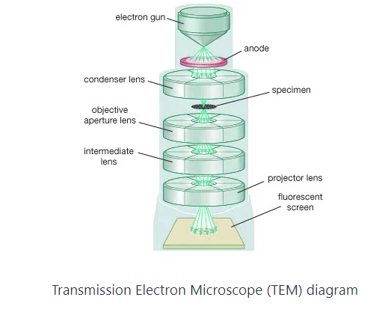

Slide 6
Scanning Electron Microscope (SEM)
An SEM creates magnified images of the specimen by probing along a rectangular area of the specimen with a focused electron beam. This process is called the raster scanning.
It is called a scanning electron microscope because the image is formed by scanning the surface of the specimen in a raster pattern using a focused electron beam.
SEM relies on the secondary emission of electrons from the surface of the specimen to achieve magnified image to be viewed.
The major advantage of a SEM over TEM is that it can produce detailed image of the whole organisms and surfaces of the cells.

Slide 7
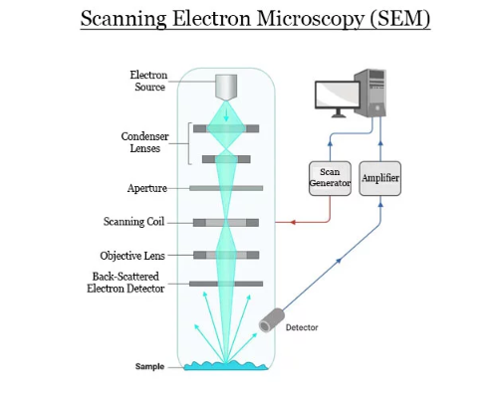

Slide 8
Difference between Transmission Electron Microscope (TEM) & Scanning Electron Microscope (SEM)
Characteristics | TEM | SEM
Resolution | 50 pm | 0.5 pm
Information from cells visualized | Inner surface | Outer surface
Type of electrons | Transmitted | Reflected
Sample preparation | Laborious | Using heavy metals
Mounting | Copper grids | Alumina stabs
Scan Coils | Absent | Present
Back scattered electron detector | Absent | Present
Image | 2-D | 3-D
Application | Ultra structure | Topography

Slide 9
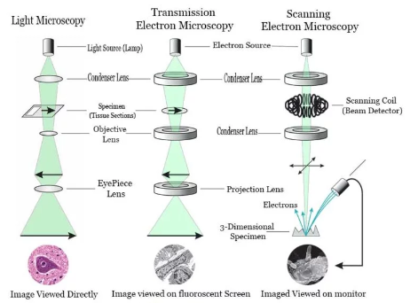
Difference between – Light microscopy, Transmission electron microscopy and Scanning electron Microscopy

Slide 10
